Slide 1

Event driven programming
Brian Tang

Slide 2
Outline
Company Overview
User Interface Development
Camera Positioning Control Feature Demo
Nexus Communication Service
Tools and Languages
Related Courses
Acknowledgements

Slide 3
Airship industries, Inc.
Specializes in surveillance system software.
Ecosystem of software components.
Primarily focuses on Windows-based applications.

Slide 4
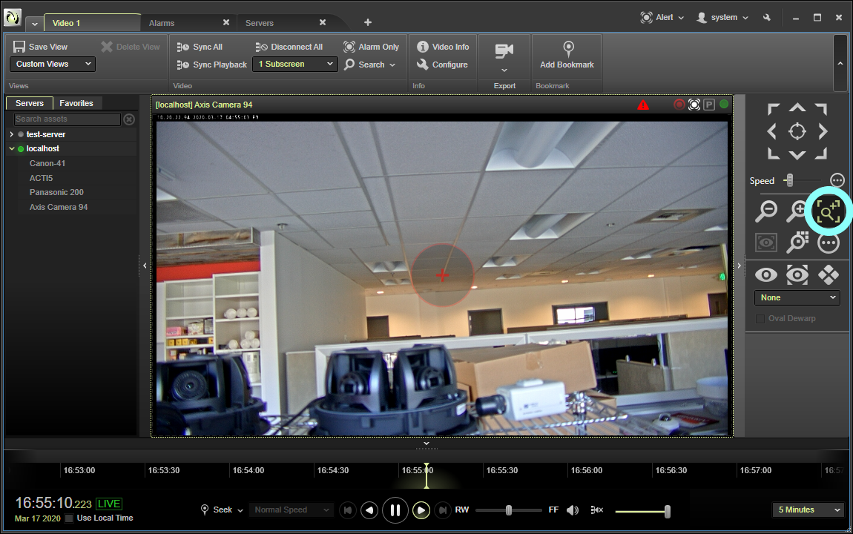
user interface development
Nexus Client is a surveillance application used to view/export camera feeds, control camera positioning, etc.
The user interface is built using a combination of XAML and C#.
Developed feature: remote camera positioning control (pan, tilt, zoom, etc.)

Slide 6
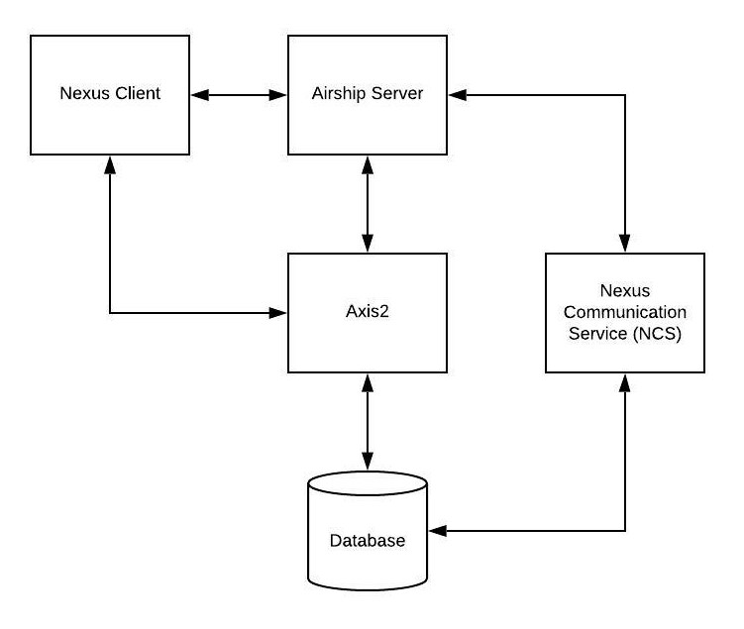
Nexus communication service - Web services
The Nexus Communication Service (NCS) is the interfacing component between Airship applications and a MySQL database.
Instead of manually building SQL queries, the NCS uses the Hibernate framework to perform queries and CRUD commands.

Slide 7
Tools and languages
Tool | Purpose | Language
Microsoft Visual Studio | Nexus Client Development | C# and XAML
JetBrains IntelliJ | NCS Development | HTML, CSS, JavaScript, Java, and SQL
FogBugz | Bug Tracking
Apache SVN | Source Control
JetBrains Upsource | Code Review

Slide 8
related coursework
Course | Application
CSE 142/143 | Object Oriented Programming
CSE 373 | Data Structures and Algorithms
CSE 410 | Multithreaded Programming (Nexus Client and NCS Development)
CSS 360 | Agile Development
CSS 370 | Software Design, UML (Job Interview)
CSS 475 | Databases Design, SQL (NCS Development)
CSS 436 | Networking, Cryptography (NCS Development)

Slide 9
acknowledgements
Dr. Munehiro Fukuda and Janet McDaniel – Thank you for guiding me through the capstone process.
Jim Qi and Nathan Duncan – Thank you for guiding me through the onboarding process at Airship.
Friends and Family – Thank you for supporting me through school and providing mental/emotional support.

Slide 10
Any questions?
Contact information:
Email: briannhtang@gmail.com LinkedIn: www.linkedin.com/in/linkbriantang

